Slide 1
Analysis of trade and emissions

Slide 2
Both papers…
Bilateral trade flows
CO₂ emissions
Relationship between trade and CO₂ emissions

Slide 3
Paper 1: Trade and the greenhouse gas emissions from international freight transport
By Anca Cristea, David Hummels, Laura Puzzello, Misak Avetisyan
Contents of interest:
Total CO₂ emissions across time (1990 to 2004)
Modal trade value shares by region
Emissions (g) per ton-km of ships with different transport modes (2004)
Trade-related emission intensity shares by regions
Relationship between GDP growth and emissions
Relationship between trade and emissions
Data collected:
Data source: GTAP 7, (aggregated to 40 regions (1600 bilateral pairs), 23 traded merchandise sectors and 6 non-traded service sectors) in 2004. GTAP: Global Trade Analysis Project
Industry level data for bilateral country pair on:
Value and weight of trade
Transport modes
CO₂ Emissions.
Emission intensity (CO₂ equivalents per dollar)
Transport emission intensity
Output/trade emission intensity

Slide 4


Calculation of transport emission intensities
Methodology (aggregation data)
Eq.1
Eq.2
E^{T}_{odg}: CO₂ emission associated with good g from origin o to destination d
VAL_{odg}: value of the trade flow
WV_{og}: weight to value ratio
Qs^{m}_{od}: quantity share of mode m in kg
DIST^{m}_{od}: distance travelled from o to d for transport mode m. (Distance data from actual ship itineraries from Hummels and Schaur.)
e^{m}: CO₂ emission produced by mode m when providing 1 kg-km of transportation
E^{t}_{o}: exporter o’s emission
S_{odg}: share of good g in total trade from o to d
e^{T}_{odg}: emissions per dollar of output from o to d

Slide 5
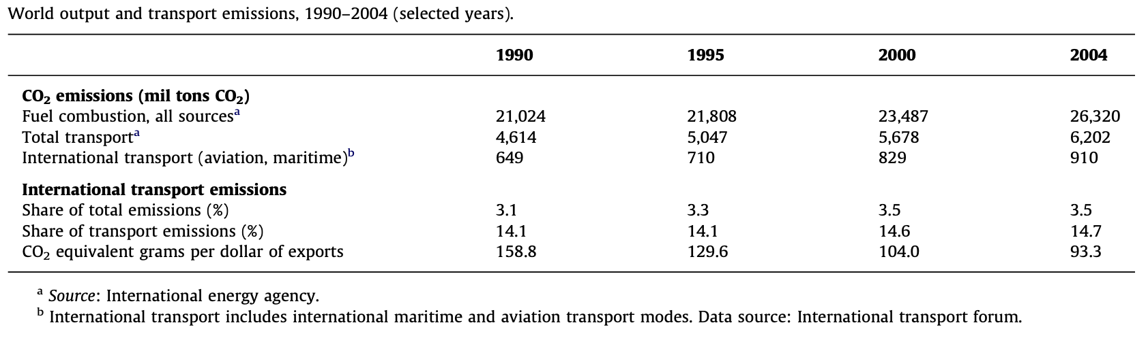
Table of emission data from shipping across time (1990 to 2004)
Calculated through eq.1
CO₂ emissions of international transport increase overtime.

Slide 6
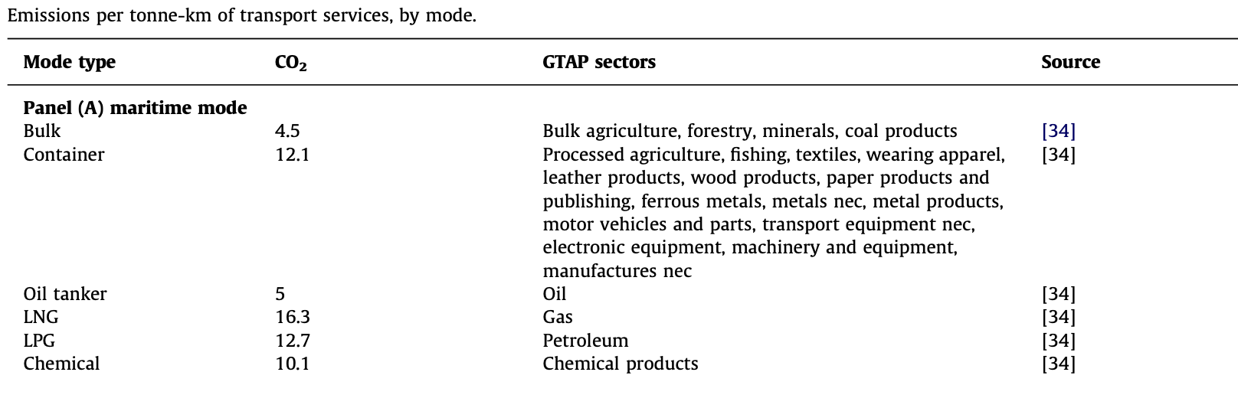
CO₂ emissions by different transport modes (aggregation data):
Emissions of CO₂ (g) per ton-km shipped for different ship types, taking into account variability across vessels of different sizes within each time.
Data source: “Ship Emissions Study”, National Technical University of Athens Laboratory for Maritime Transport.
Calculated through eq.1

Slide 7
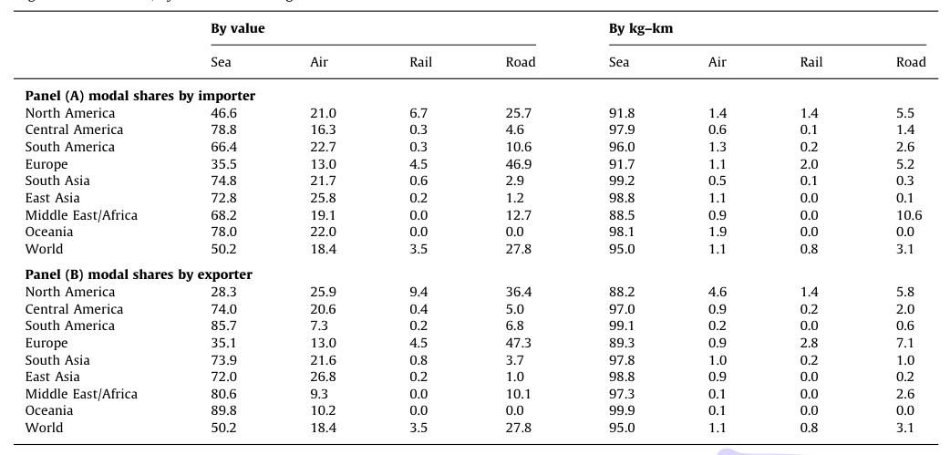
Table of regional modal shares (by trade value and kg-km)
Transportation services employed by trade
Source: GTAP 7
Sea transport dominates 95% of transportation services.
Central America as importer: Highest seaborne trade value share
Oceania as exporter: Highest seaborne trade value share

Slide 8




Calculation of output emission intensities of trade and effects of growing trade on emissions growth (consists of production and transport emission intensities)
Methodology:
CGE simulation to generate changes in the value and composition of trade resulting from tariff liberalization and GDP growth.
E^{Y}_{og}: emissions from good g in country o
Y_{og}: product of output($)
e^{Y}_{og}: emissions per dollar of output
Eq.3
Eq.5
E^{Y}_{o}: aggregated emissions in country o
Y_{o}: product of output ($)
S_{g}: share of good g in total trade
E_{odg}: CO₂ emission associated with good g from origin o to destination d
VAL_{odg}: value of the trade flow
e^{T}_{odg}: emissions per dollar of output from o to d
Eq.4
Eq.6

Slide 9
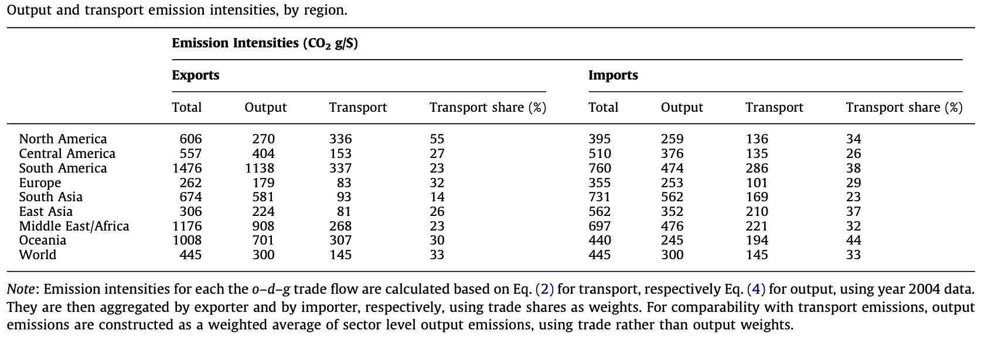
Table of emission intensities by region
Calculated through eq.1 & eq.3
Reliance on emission intensive commodity production → very high output emissions per dollar on trade of South America, Oceania and the Middle East/Africa
Higher export emission intensity in North America
Higher import emission intensity in East Asia

Slide 10
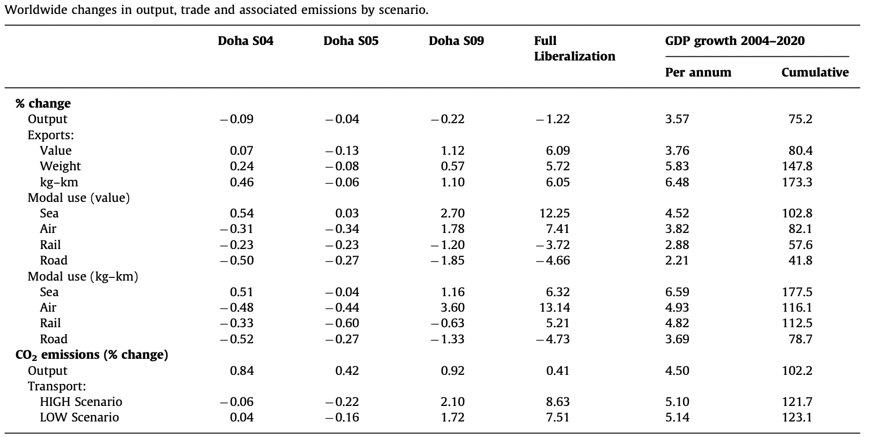
%Change in output, trade and associated emissions (aggregated)
Assumptions:
Fixed emission intensity of a particular output trade sector
Fixed modal shares for each o-d-g flow (from o to d, good g)
Not taking into account for changes in fuel prices
Growth in air and sea transport and shrinkage in rail and road transport.
Positive growths of output CO₂ emissions.
Estimated GDP growth per annum due to sea transports increases across 2004 to 2020. → growth in emissions overall
Doha S04 & S05: agricultural market access
Doha S09: both agricultural and non-agricultural market access
Calculated through eq.5 & eq.6

Slide 11

Calculation of changes in emissions associated with trade
Methodology:
Partial equilibrium calculation
Assumptions:
Fixed overall consumption
Require each country to produce all consumption locally
Negative value of δE_{odg} → Difference in output emissions is enough to offset emissions from transport
E_{odg}: CO₂ emission associated with good g from origin o to destination d
e^{Y}_{og}: emissions per dollar of output at o
e^{Y}_{dg}: emissions per dollar of output at d
e^{T}_{odg}: emissions per dollar of output from o to d
VAL_{odg}: value of the trade flow
Small differences in output & transport emission intensities → positive relationship between trade and emissions
Incorporating transportation → Lower emission intensives

Slide 12
Paper 2: Trade-linked shipping CO₂ emissions
By Xiao-Tong Wang, Huan Liu, Zhao-Feng, …+8
Contents of interest:
Bilateral trade flows and global international shipping emissions in 2018
Trade-linked indicators that measure shipping emissions efficiency (TEEI-W (by weight) and TEEI-V (by value))
Estimation of international trade-driven shipping emissions
Relationship between trade and emissions
Methodology:
VoySEIM (Ship Emission Inventory Model): voyage-based shipping emission estimations and EEOIs between the departure and arrival countries.
Mainly multitudinous trade flows
GTEMs: trade-linked shipping emission estimations
International trade-driven shipping emissions estimation

Slide 13
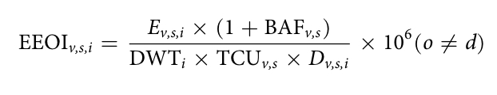
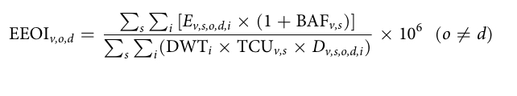
Calculation of TEEI-W (by weight) and TEEI-V (by value)
VoySEIM
GTEMS
+
TEEI (Trade efficiency index)
Bilateral trade volume ad structure, fleet size and voyage composition
VoySEIM:
EEOI_{v,s,i}: energy efficiency operational indicator for each voyage I, vessel type v and size bin s (gCO₂ton⁻¹NM⁻¹)
E_{v,s,i}: estimated shipping CO₂ emissions by voyage I, vessel type v (containers, etc) and size bin s (tons)
BAF_{v,s}: berthing adjust factor
DWT_{i}: dead weight tonnage of voyage I
TCU_{v,s}: total actual transport work for vessel type v and size bin s
D_{v,s,i}: shipping distance (NM) (calculated by applying the great-circle distance algorithm to the position sequence and accumulating the results from all segments)
GTEMS:
EEOI_{v,o,d}: averaged EEOI by vessel type v and country pair o,d (gCO₂ton⁻¹NM⁻¹)

Slide 14
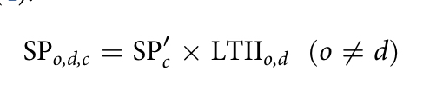
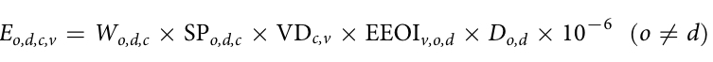
Estimation of international trade-driven shipping emissions based on TEEI (advanced indicator of EEOI)
SP_{o,d,c}: seaborne proportion of trade commodity c
SP’_{c}: seaborne proportion pre-estimated based on transoceanic countries in modal-split trade data
LTII: land transport infeasibility index.
E_{o,d,c,v}: shipping CO₂ emissions driven by trade commodity c from o to d, transported by vessel type v (tons)
W_{o,d,c}: total weight of commodity c (tons)
VD_{c,v}: vessel distribution coefficient of commodity c carried by vessel v
D_{o,d}: shipping distance (spatial info from AIS to simulate bilateral route distances and calculate the shortest path between each set of 2 nodes using the Dijkstra shortest-path algorithm)
Source: the Base pour l’Analyse du Commerce International (BACI) database developed by Le Centre d’études prospectives et d’informations internationales, modal-split trade data from the United Nation (UN) Comtrade database (https:// comtrade.un.org/data), the Eurostat database (https://ec.europa.eu/eurostat/data/ database) and the US census (https://usatrade.census.gov).

Slide 15
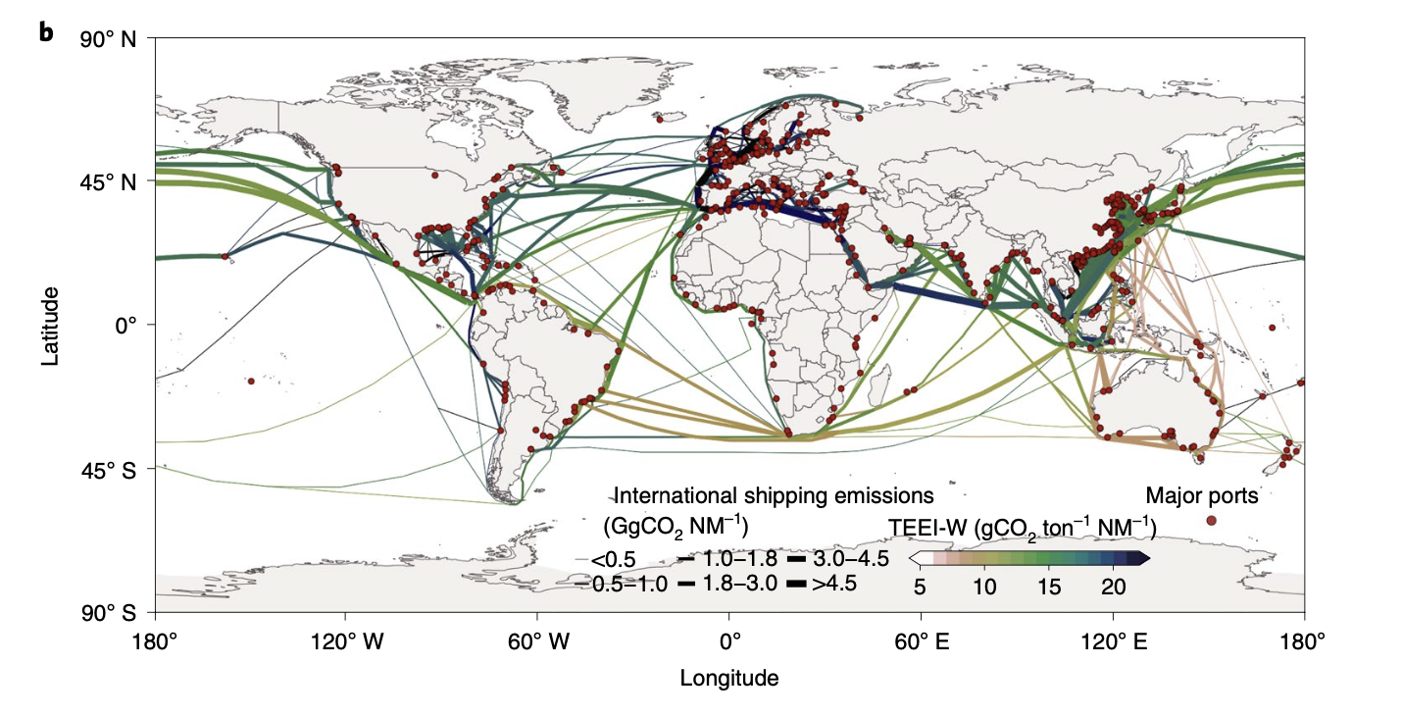
Findings of TEEI-W and international shipping emissions
Dense shipping emissions on the circum-equatorial corridor
Highest emission intensity of CO2: 22.1GgNM⁻¹, the channel linking East Asia and Europe.
Mainly energy-intensive vessels (container ships) in Europe → Highest TEEI-W in Europe
Frequent energy-efficient vessels (bulk carriers) in the Southern Hemisphere → Lower TEEI-W.

Slide 16
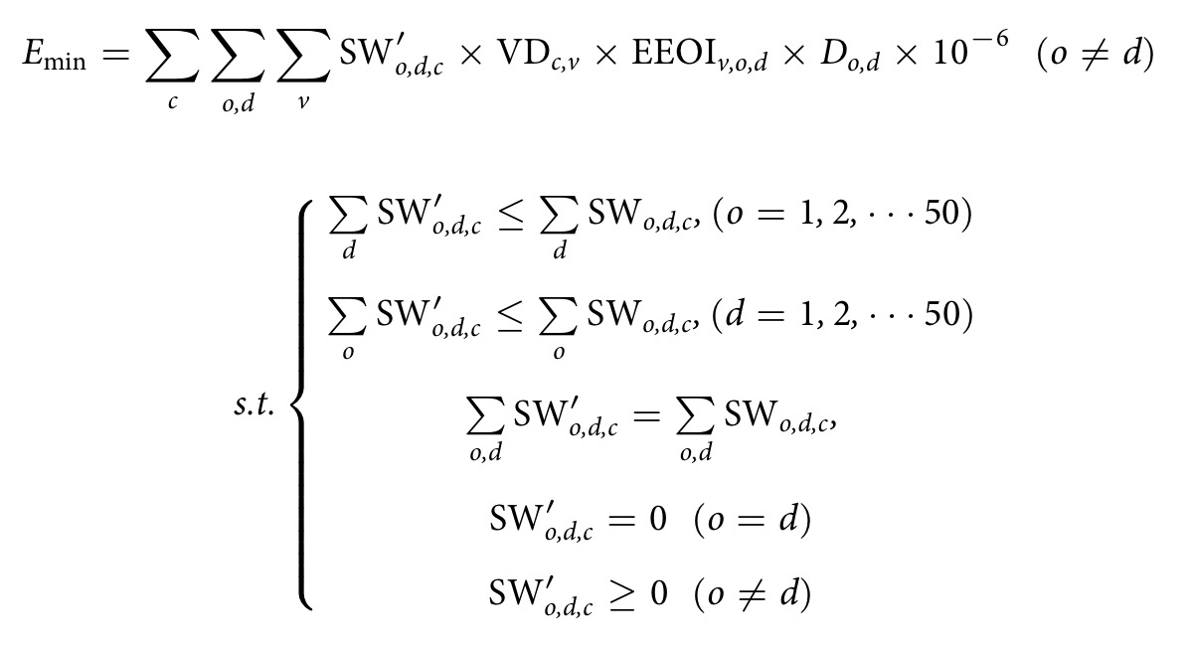
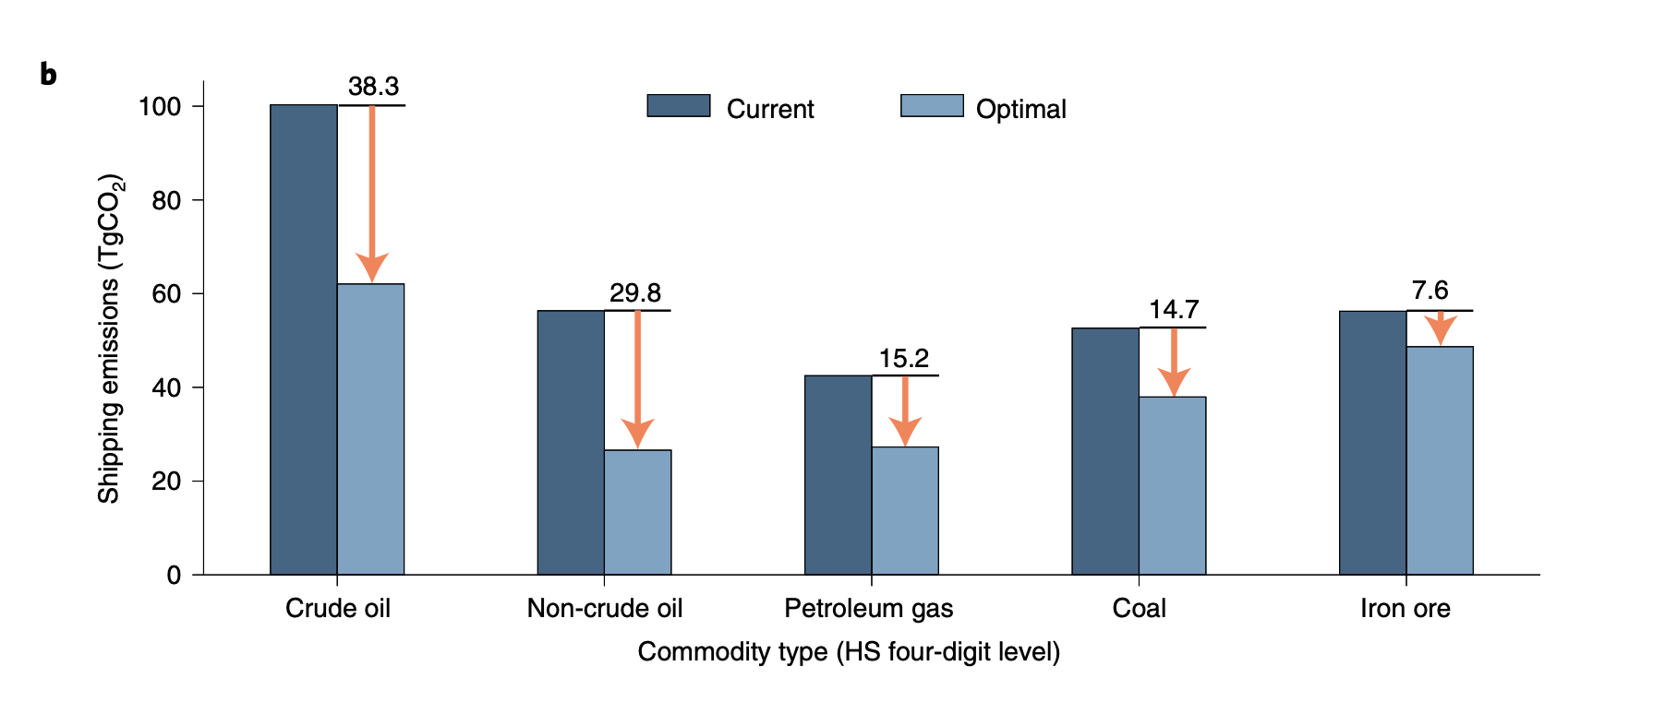
Relationship between trade and emissions
E_{min}: minimum total international shipping CO₂ emissions (tons)
SW_{o,d,c}: current weight of seaborne trade of commodity c from o to d (tons)
SW’_{o,d,c}: optimal SW_{o,d,c}
VD_{c,v}: vessel distribution coefficient of commodity c carried by vessel type v
D_{o,d}: shipping distance (NM)
EEOI_{v,o,d}: averaged EEOI by vessel type v and country pair o,d (gCO₂ton⁻¹NM⁻¹)
Conclusion:
Unchanged import and export trade volume of each commodity, with optimized trading partners → global shipping CO₂ emissions of international trade commodities can be reduced by 38%.

Slide 17
Bibliography
Paper 1: https://www.sciencedirect.com/science/article/pii/S0095069612000708
Paper 2: File will be uploaded

